Slide 1
Statistical Learning on Credit Data
Build Models to Predict Loan defaults
Firas Obeid
Ex Treasury Dealer

Slide 2
Problem Identification
Lending Club Data
Loan Data
Goal: Predict Loan Defaults using set of variables
Process : Statistical Learning Models

Slide 3
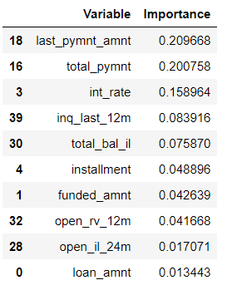
Data Preparation
Identify data types
Fill missing values
Convert nonnumeric variables
Drop unnecessary variables

Slide 4
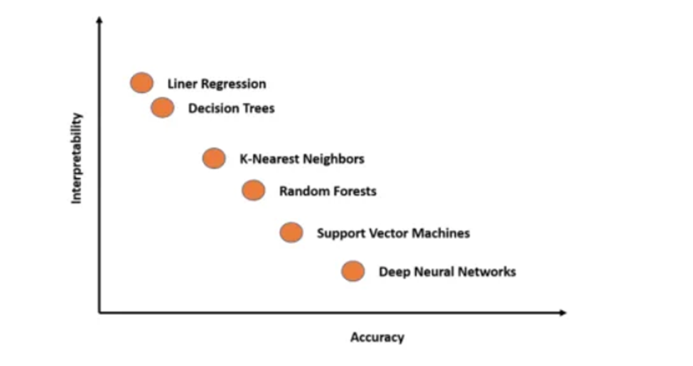
Statistical Models
“As far as the laws of mathematics refer to reality, they are not certain; and as far as they are certain, they do not refer to reality.”~ Einstein
Many machine learning algorithms are stochastic because they explicitly use randomness during optimization or learning.

Slide 5






Model Interpretation
Are we using blackboxes?

Slide 6
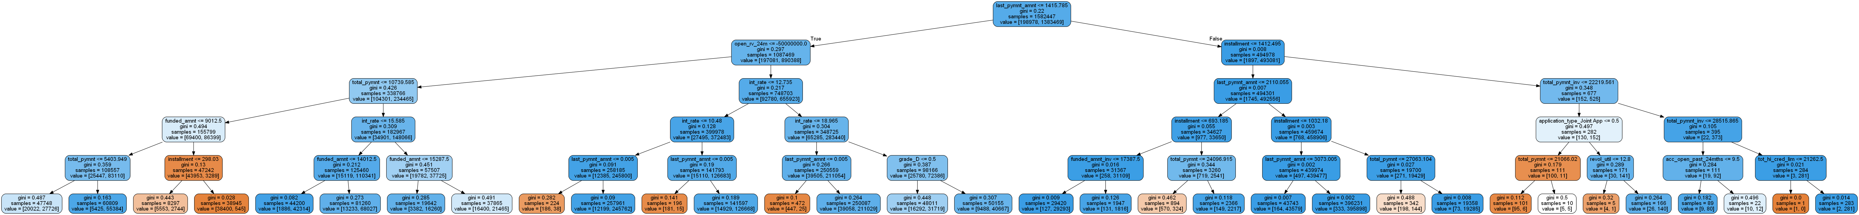
Tree Based Model - GBM

Slide 7
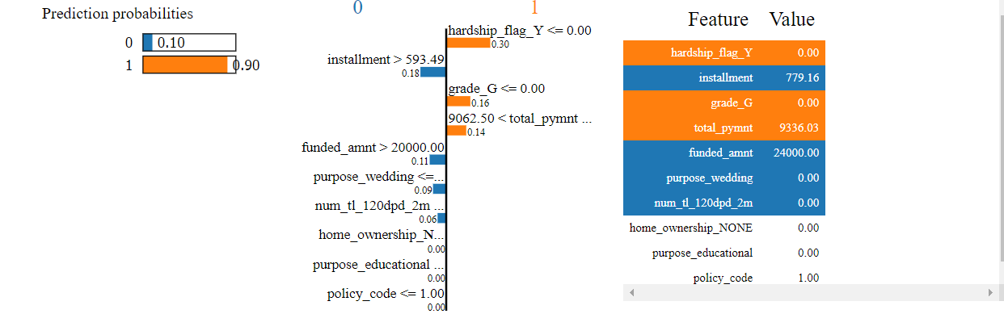
Tree Based Model - GBM
LIME (Local Interpretable Model Agnostic Explanations)

Slide 8
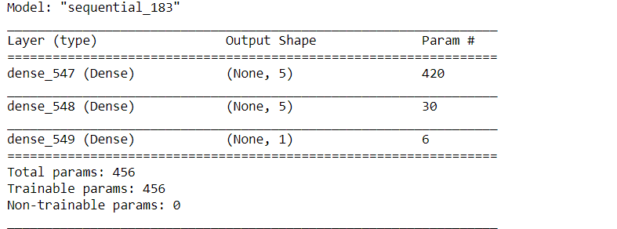
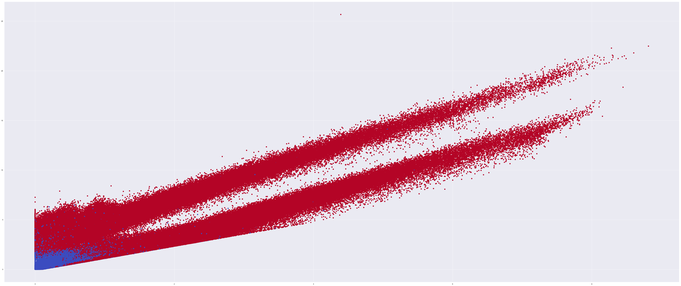
Neural Network
Fitted on Important Identified variables by previous model

Slide 9
Logistic Regression – NN Interpreter
Number of Iterations/Epochs: * Solution: Make epochs = max_iter
Optimizer : * Solution: Optimizer = 'sgd' (stochastic gradient decsent Solver = 'sag' (stochastic average gradient descent)
Regularization: * Solution: l2 in both
The L2 regularization (also called Ridge): For l2 / Ridge, as the penalisation increases, the coefficients approach but do not equal zero, hence no variable is ever excluded!

Slide 10
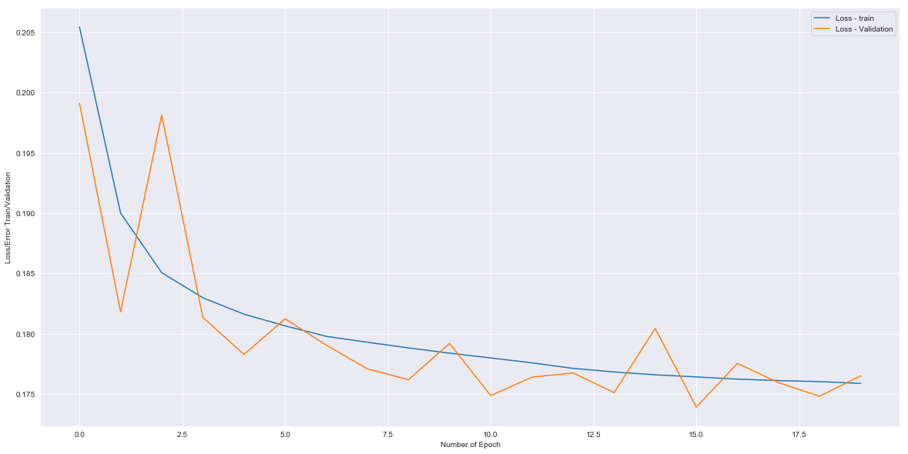
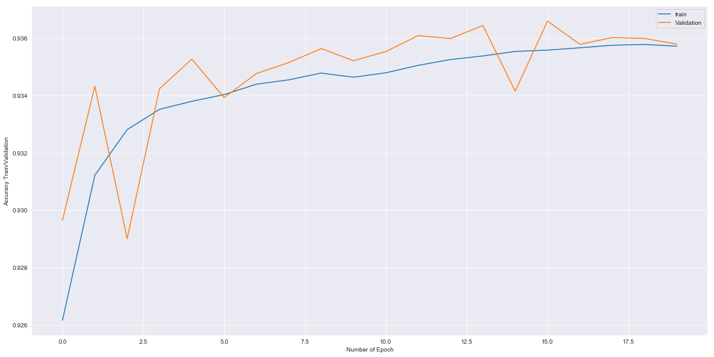
Model Stability
For high-bias models, the performance of the model on the validation set is similar to the performance on the training set.
For high-variance models, the performance of the model on the validation set is far worse than the performance on the training set.

Slide 11
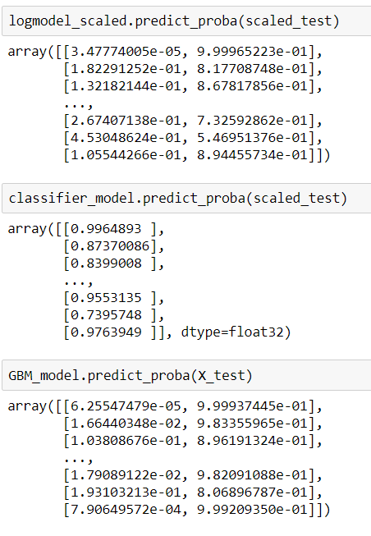
Model Deployment
Probability of Default from model predictions
Use Probabilities of observations to assign buckets that group customers according to default rate

Slide 12
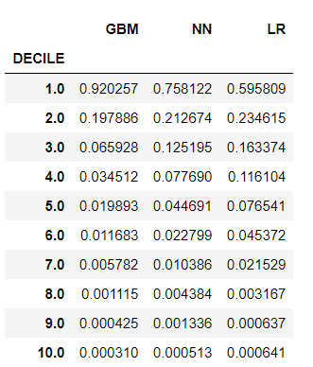
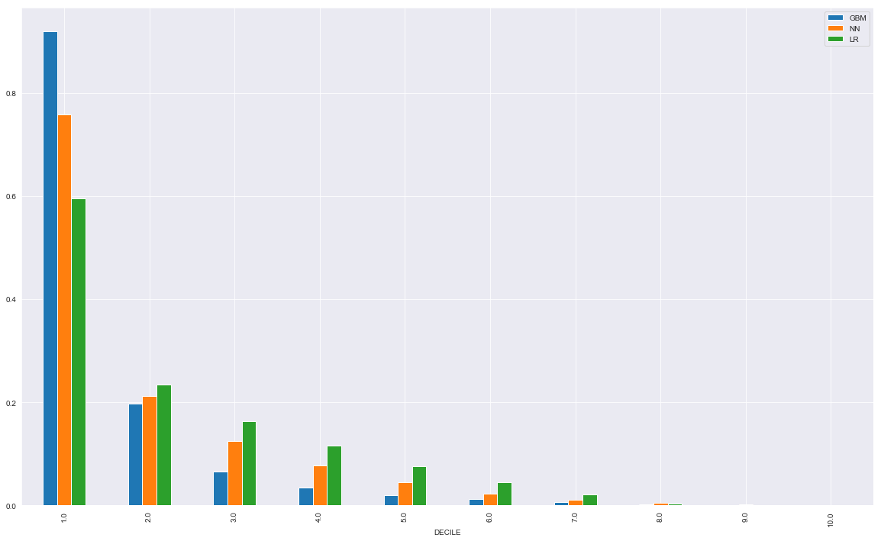
Scorecard (Segmentation & Pricing)

Slide 13
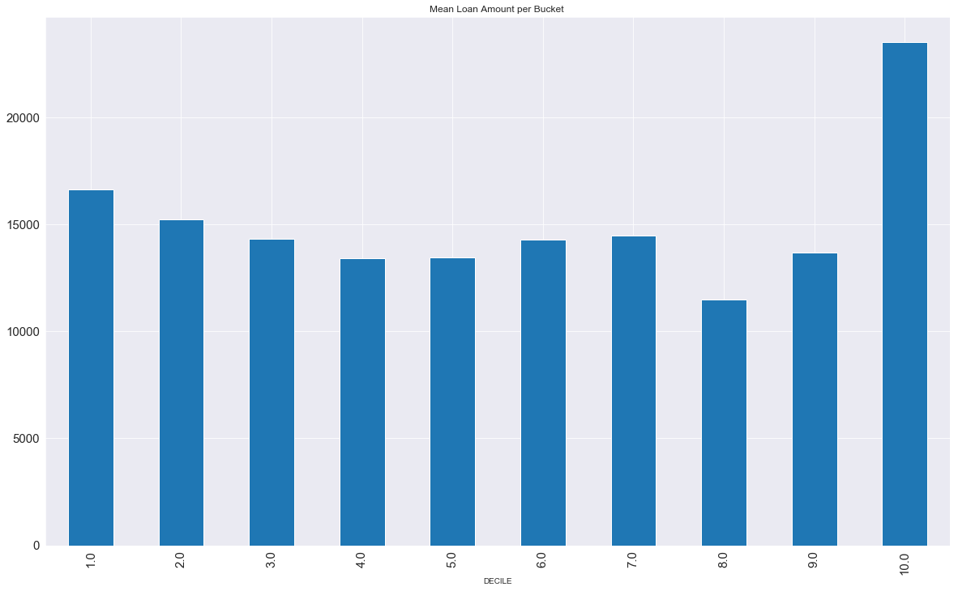
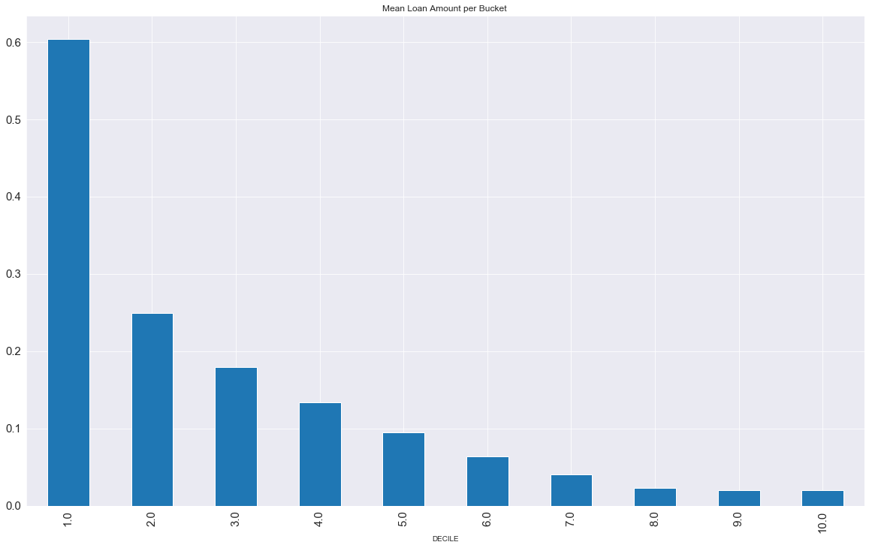
Scorecard (Segmentation & Pricing)
Mean Loan amount per bucket
Interest Rate Proposed per Bucket

Slide 14
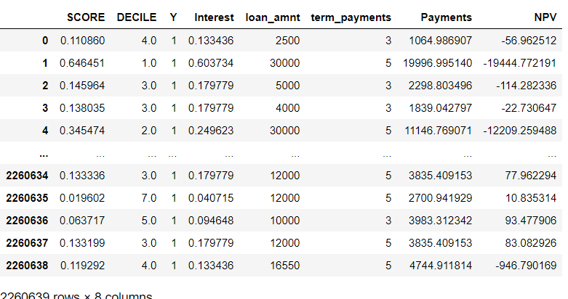
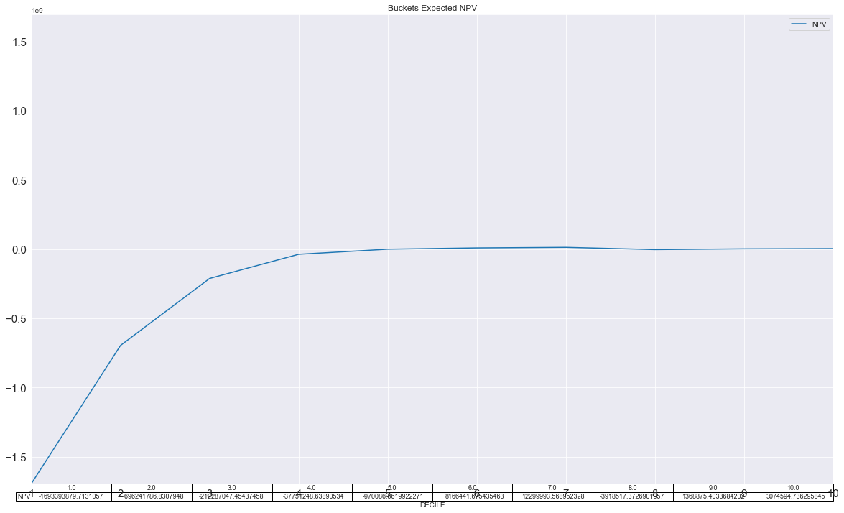
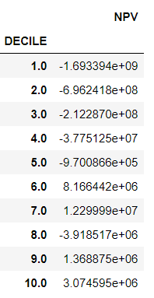
Bucket NPV

Slide 15
Conclusion
Using statistical models that assign probability to classified classes, help allocate operational risk capital by identifying level of customer riskiness. The method of segmenting customer into buckets using the scorecard approach, identifies:
Level of operational and default risk a financial entity is willing to take,
The customer base to choose
The appropriate interest rate to charge and price loan/credit product repayments.

